Slide 1

Neural Network
Mr. Arpit Yadav
Senior Data Scientist
Phd Scholar in AIML
INSOFE, Bangalore

Slide 2
MNIST
Foundations of Convolutional Neural Networks
The objectives behind the Convolutional Neural Networks :
To understand the convolution operation
To understand the pooling operation
Remembering the Hyperparameters used in convolutional neural networks (padding, stride, filter, etc.)
Building a convolutional neural network for multi-class classification in images

Slide 3
MNIST
Foundations of Convolutional Neural Networks
In a convolutional network (ConvNet), There are four main operations in a CNN:
Convolution
Non Linearity (ReLU)
Pooling or Sub Sampling
Classification (Fully Connected Layer)

Slide 4
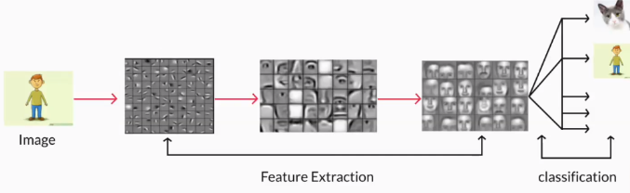
CNN

Slide 5
MNIST
Foundations of Convolutional Neural Networks
What is Convolution in CNN?

Slide 6
MNIST
Foundations of Convolutional Neural Networks
What is Convolution in CNN?
The term convolution refers to the mathematical combination of two functions to produce a third function.
It merges two sets of information. In the case of a CNN, the convolution is performed on the input data with the use of a filter or kernel (these terms are used interchangeably) to then produce a feature map.

Slide 7
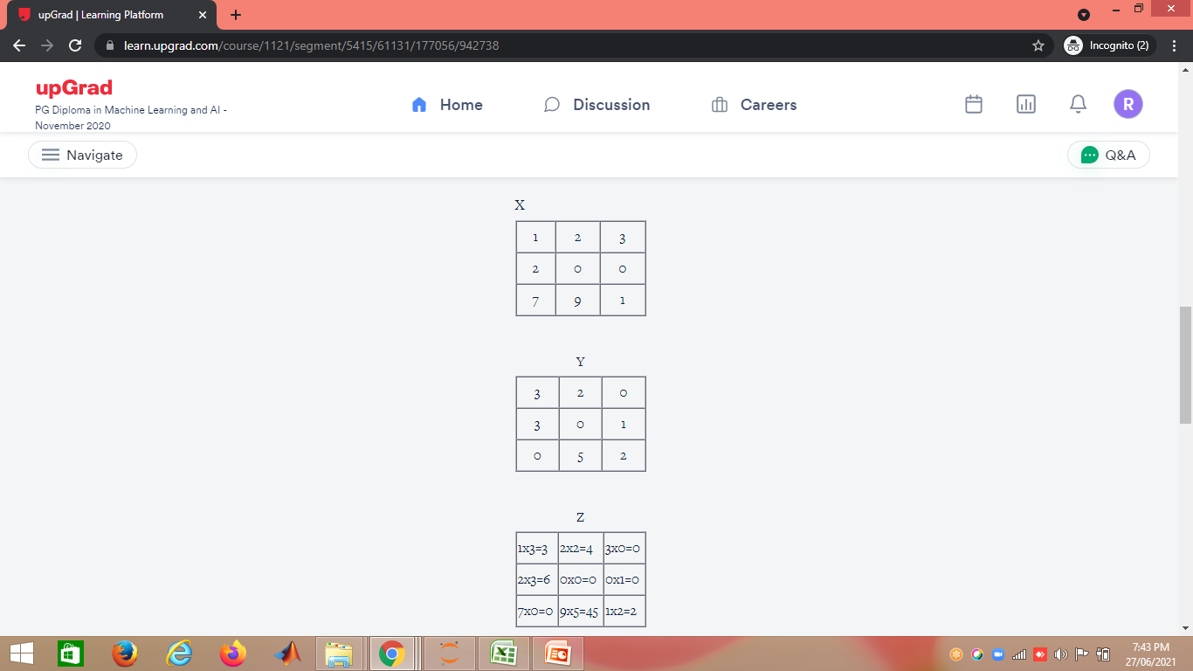
MNIST
Foundations of Convolutional Neural Networks
What is Convolution in CNN?
Mathematically, the convolution operation is the summation of the element-wise product of two matrices. Let’s take two matrices, X and Y. If you 'convolve the image X using the filter Y', this operation will produce the matrix Z.
Finally, you compute the sum of all the elements in Z to get a scalar number, i.e. 3+4+0+6+0+0+0+45+2 = 60.

Slide 8
MNIST
Convolutional Layer IN CNN
The first layer of a Convolutional Neural Network is always a Convolutional Layer.
Convolutional layers apply a convolution operation to the input, passing the result to the next layer.
A convolution converts all the pixels in its receptive field into a single value.
For example, if you would apply a convolution to an image, you will be decreasing the image size as well as bringing all the information in the field together into a single pixel.
The final output of the convolutional layer is a vector.
Based on the type of problem we need to solve and on the kind of features we are looking to learn, we can use different kinds of convolutions.

Slide 9
MNIST
Convolutional Layer IN CNN
The 2D Convolution Layer
The most common type of convolution that is used is the 2D convolution layer and is usually abbreviated as conv2D.
A filter or a kernel in a conv2D layer “slides” over the 2D input data, performing an elementwise multiplication.
As a result, it will be summing up the results into a single output pixel.
The kernel will perform the same operation for every location it slides over, transforming a 2D matrix of features into a different 2D matrix of features.

Slide 12
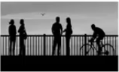
MNIST
Edge Detection Example
In the previous article, we saw that the early layers of a neural network detect edges from an image. Deeper layers might be able to detect the cause of the objects and even more deeper layers might detect the cause of complete objects (like a person’s face).
In this section, we will focus on how the edges can be detected from an image. Suppose we are given the below image:

Slide 13
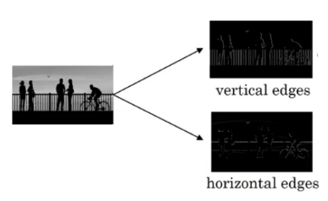
MNIST
Edge Detection Example
As you can see, there are many vertical and horizontal edges in the image. The first thing to do is to detect these edges::

Slide 14
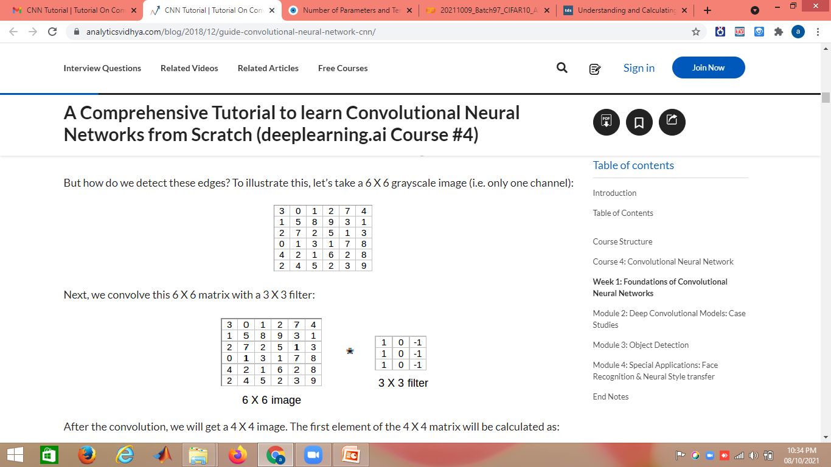

Slide 15
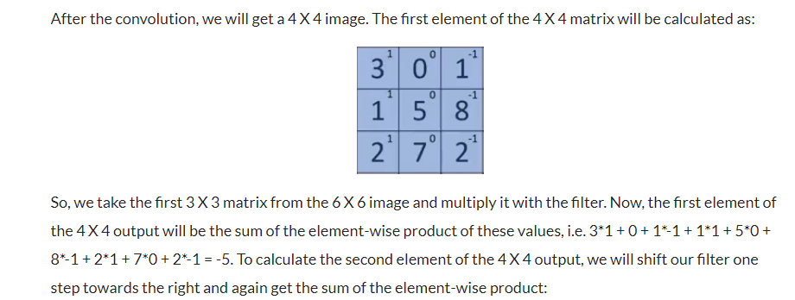

Slide 16
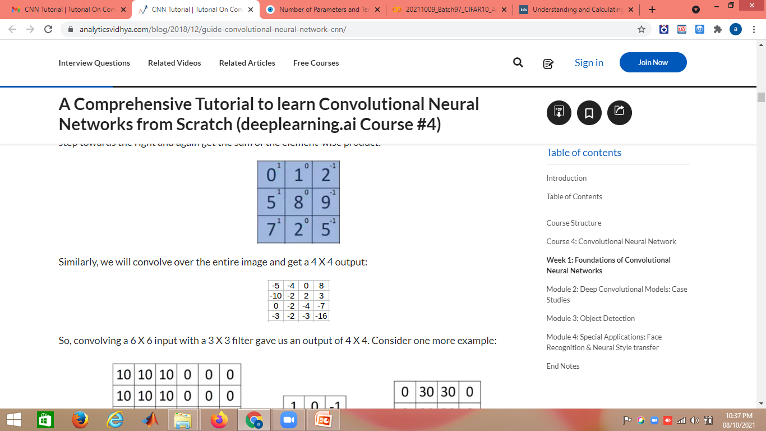

Slide 17
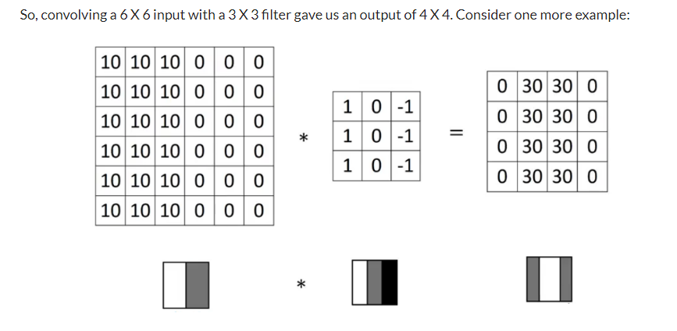
Note: Higher pixel values represent the brighter portion of the image and the lower pixel values represent the darker portions. This is how we can detect a vertical edge in an image.

Slide 18
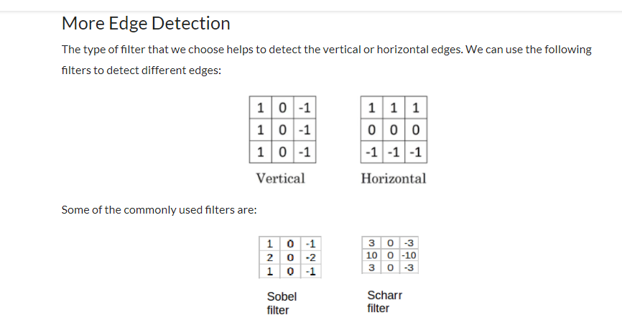
The Sobel filter puts a little bit more weight on the central pixels. Instead of using these filters, we can create our own as well and treat them as a parameter which the model will learn using backpropagation.

Slide 19
MNIST
CNN Example
Why Convolutions?
There are primarily two major advantages of using convolutional layers over using just fully connected layers:
Parameter sharing
Sparsity of connections

Slide 20
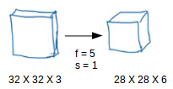
MNIST
CNN Example
Why Convolutions?
Consider the below example:
If we would have used just the fully connected layer, the number of parameters would be = 32*32*3*28*28*6, which is nearly equal to 14 million! Makes no sense, right?
If we see the number of parameters in case of a convolutional layer, it will be = (5*5 + 1) * 6 (if there are 6 filters), which is equal to 156. Convolutional layers reduce the number of parameters and speed up the training of the model significantly.

Slide 21
MNIST
CNN Example
Why Convolutions?
Consider the below example:
In convolutions, we share the parameters while convolving through the input. The intuition behind this is that a feature detector, which is helpful in one part of the image, is probably also useful in another part of the image. So a single filter is convolved over the entire input and hence the parameters are shared.
The second advantage of convolution is the sparsity of connections. For each layer, each output value depends on a small number of inputs, instead of taking into account all the inputs.

Slide 22
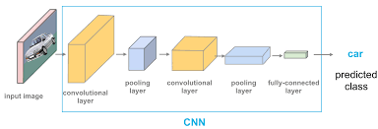

Slide 23
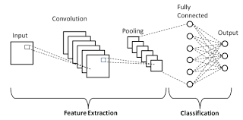

Slide 24
MNIST
Foundations of Convolutional Neural Networks
Why to use Pooling Layers?

Slide 25
MNIST
Foundations of Convolutional Neural Networks
Pooling Layers
Pooling layers are generally used to reduce the size of the inputs and hence speed up the computation.
Pooling layers are used to reduce the dimensions of the feature maps.
Thus, it reduces the number of parameters to learn and the amount of computation performed in the network.
This makes the model more robust to variations in the position of the features in the input image

Slide 26
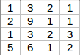
MNIST
Foundations of Convolutional Neural Networks
Pooling Layers
Pooling layers are generally used to reduce the size of the inputs and hence speed up the computation. Consider a 4 X 4 matrix as shown below:

Slide 27
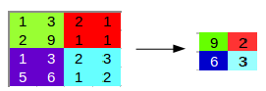
MNIST
Foundations of Convolutional Neural Networks
Pooling Layers
Applying max pooling on this matrix will result in a 2 X 2 output:

Slide 28
MNIST
Foundations of Convolutional Neural Networks
The three types of pooling operations are:
Max pooling: The maximum pixel value of the batch is selected.
Min pooling: The minimum pixel value of the batch is selected.
Average pooling: The average value of all the pixels in the batch is selected.

Slide 31
MNIST
Pooling Layers
For every consecutive 2 X 2 block, we take the max number. Here, we have applied a filter of size 2 and a stride of 2. These are the hyperparameters for the pooling layer. Apart from max pooling, we can also apply average pooling where, instead of taking the max of the numbers, we take their average. In summary, the hyperparameters for a pooling layer are:
Filter size
Stride
Max or average pooling
If the input of the pooling layer is n_{h} X n_{w} X n_{c}, then the output will be [{(n_{h} – f) / s + 1} X {(n_{w} – f) / s + 1} X n_{c}].

Slide 32
Why Padding is Needed in CNN?

Slide 33
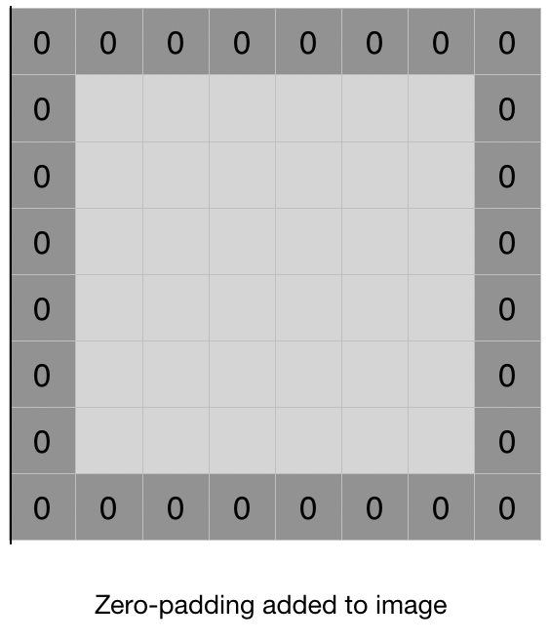
Why Padding is Needed in CNN?
Padding is simply a process of adding layers of zeros to our input images so as to avoid the problems mentioned above.

Slide 34
Padding
We have seen that convolving an input of 6 X 6 dimension with a 3 X 3 filter results in 4 X 4 output. We can generalize it and say that if the input is n X n and the filter size is f X f, then the output size will be (n-f+1) X (n-f+1):
Input: n X n
Filter size: f X f
Output: (n-f+1) X (n-f+1)
There are primarily two disadvantages here:
Every time we apply a convolutional operation, the size of the image shrinks
Pixels present in the corner of the image are used only a few number of times during convolution as compared to the central pixels. Hence, we do not focus too much on the corners since that can lead to information loss

Slide 35
Padding
To overcome these issues, we can pad the image with an additional border, i.e., we add one pixel all around the edges. This means that the input will be an 8 X 8 matrix (instead of a 6 X 6 matrix). Applying convolution of 3 X 3 on it will result in a 6 X 6 matrix which is the original shape of the image. This is where padding comes to the fore:
Input: n X n
Padding: p
Filter size: f X f
Output: (n+2p-f+1) X (n+2p-f+1)

Slide 36
Padding
There are two common choices for padding:
Valid: It means no padding. If we are using valid padding, the output will be (n-f+1) X (n-f+1)
Same: Here, we apply padding so that the output size is the same as the input size, i.e., n+2p-f+1 = n So, p = (f-1)/2
We now know how to use padded convolution. This way we don’t lose a lot of information and the image does not shrink either. Next, we will look at how to implement strided convolutions.

Slide 38
Why Stride is Needed in CNN?

Slide 39
Why Stride is Needed in CNN?
Strides:
Stride is the number of pixels shifts over the input matrix. When the stride is 1 then we move the filters to 1 pixel at a time. When the stride is 2 then we move the filters to 2 pixels at a time and so on.
Stride is a parameter of the neural network's filter that modifies the amount of movement over the image or video. For example, if a neural network's stride is set to 1, the filter will move one pixel, or unit, at a time.

Slide 40
Strided Convolutions
Suppose we choose a stride of 2. So, while convoluting through the image, we will take two steps – both in the horizontal and vertical directions separately.
The dimensions for stride s will be:
Input: n X n
Padding: p
Stride: s
Filter size: f X f
Output: [(n+2p-f)/s+1] X [(n+2p-f)/s+1]
Stride helps to reduce the size of the image, a particularly useful feature.

Slide 42
Convolutions Over Volume
Suppose, instead of a 2-D image, we have a 3-D input image of shape 6 X 6 X 3. How will we apply convolution on this image? We will use a 3 X 3 X 3 filter instead of a 3 X 3 filter. Let’s look at an example:
Input: 6 X 6 X 3
Filter: 3 X 3 X 3
The dimensions above represent the height, width and channels in the input and filter. Keep in mind that the number of channels in the input and filter should be same. This will result in an output of 4 X 4. Let’s understand it visually:

Slide 43
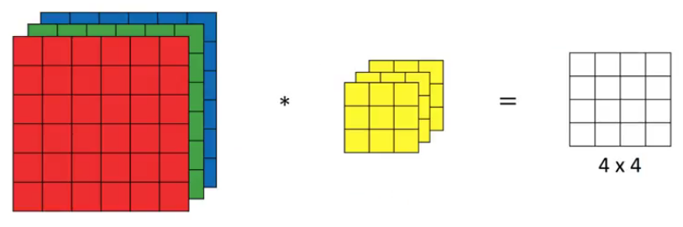
Since there are three channels in the input, the filter will consequently also have three channels. After convolution, the output shape is a 4 X 4 matrix. So, the first element of the output is the sum of the element-wise product of the first 27 values from the input (9 values from each channel) and the 27 values from the filter. After that we convolve over the entire image.

Slide 44
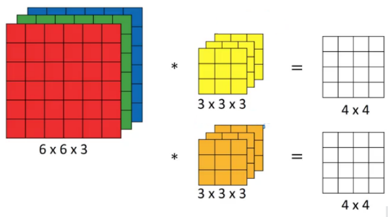
Instead of using just a single filter, we can use multiple filters as well. How do we do that? Let’s say the first filter will detect vertical edges and the second filter will detect horizontal edges from the image. If we use multiple filters, the output dimension will change. So, instead of having a 4 X 4 output as in the above example, we would have a 4 X 4 X 2 output (if we have used 2 filters):

Slide 45
Generalized dimensions can be given as:
Input: n X n X n_{c}
Filter: f X f X n_{c}
Padding: p
Stride: s
Output: [(n+2p-f)/s+1] X [(n+2p-f)/s+1] X n_{c}’
Here, n_{c} is the number of channels in the input and filter, while n_{c}’ is the number of filters.

Slide 46
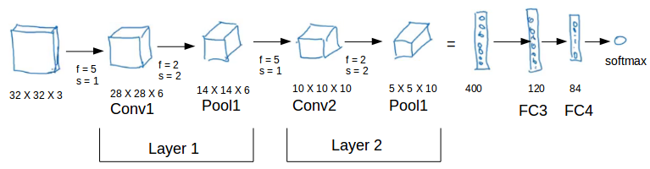
MNIST
CNN Example
We’ll take things up a notch now. Let’s look at how a convolution neural network with convolutional and pooling layer works. Suppose we have an input of shape 32 X 32 X 3:

Slide 47
MNIST
CNN Example
There are a combination of convolution and pooling layers at the beginning, a few fully connected layers at the end and finally a softmax classifier to classify the input into various categories. There are a lot of hyperparameters in this network which we have to specify as well.
Generally, we take the set of hyperparameters which have been used in proven research and they end up doing well. As seen in the above example, the height and width of the input shrinks as we go deeper into the network (from 32 X 32 to 5 X 5) and the number of channels increases (from 3 to 10).

Slide 48
